Slide 1
FTMS Final Presentation
Presented by Jared, Jennifer & Christian
SERP Group 3

Slide 2
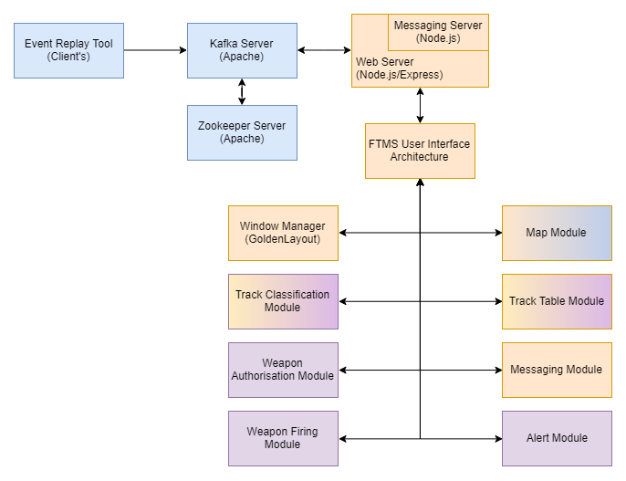
System Architecture & Work Distribution
Christian
Jared
Jennifer
Notes:
https://drive.google.com/file/d/1sOKyIRdj8V_JkrLntri8B_BhI4_1WhJT/view?usp=sharing

Slide 3
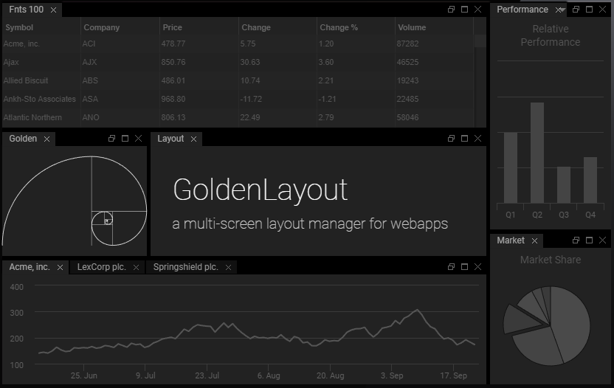

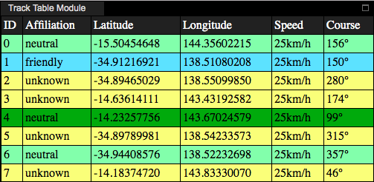
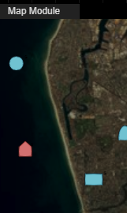
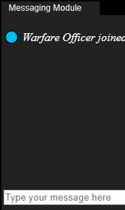

Work Overview
Web Server, Framework, UI Architecture
Node.js, Express, OOP
Modules
Track Table, Map, Messaging
Window Manager
GoldenLayout

Slide 4


Web Servers & Frameworks
Written in Python
Slow but powerful and flexible
Easy to change architecture if necessary
Relatively new; not much support
Written in Javascript
Fast, consistent and flexible
Large amount of plugins
Full-stack - Javascript used for frontend & backend
Easy to change architecture if necessary
Relatively new; lots of support
Written in Ruby
Powerful but restrictive
Great for MVC structured systems
Strong database support
Large amount of plugins
Relatively old; lots of support

Slide 5
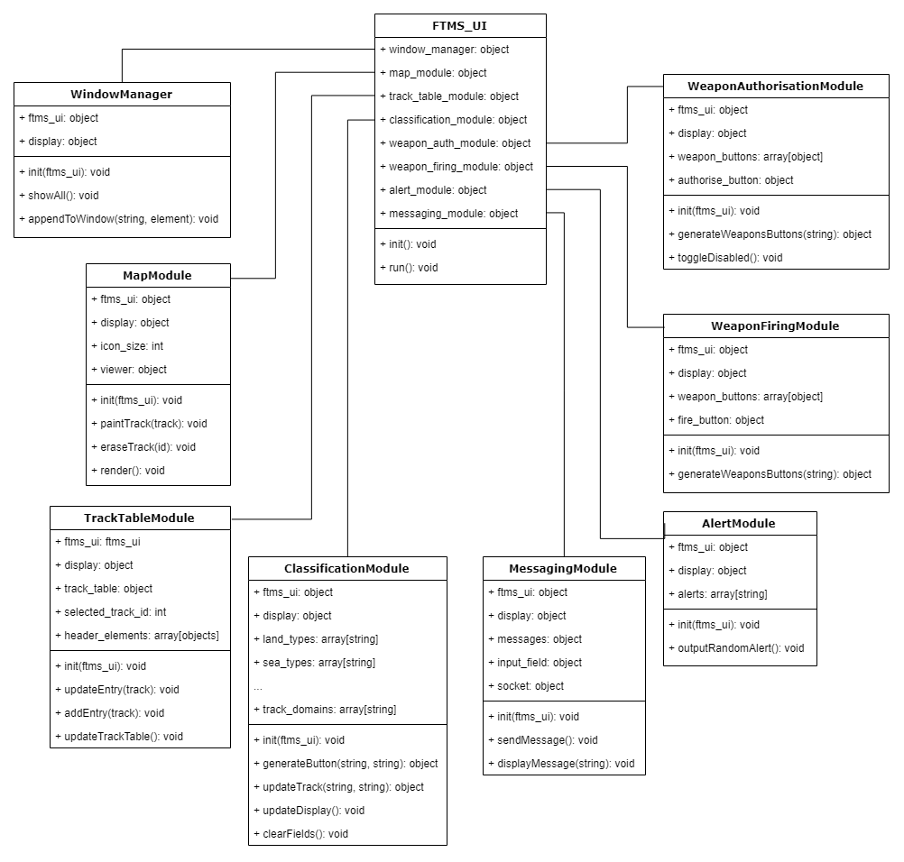
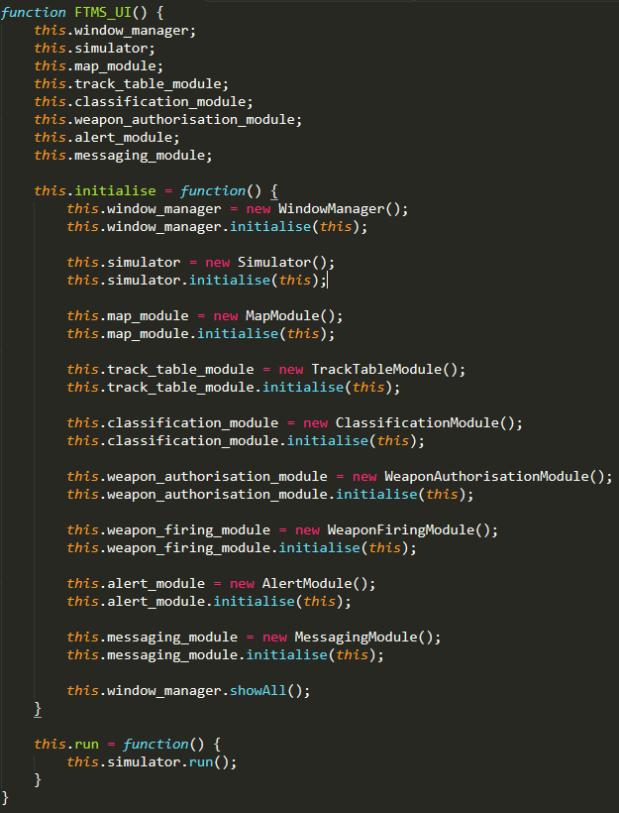
UI Architecture
Notes:
Class diagram edit link: https://drive.google.com/file/d/1SSqM_zGp69IeXLvkelszVonnntT8hnyV/view?usp=sharing

Slide 6


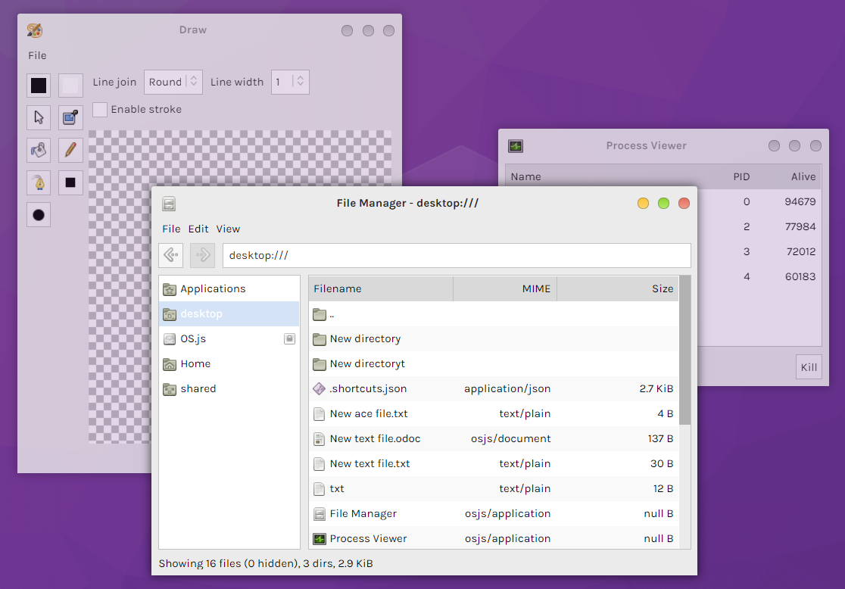
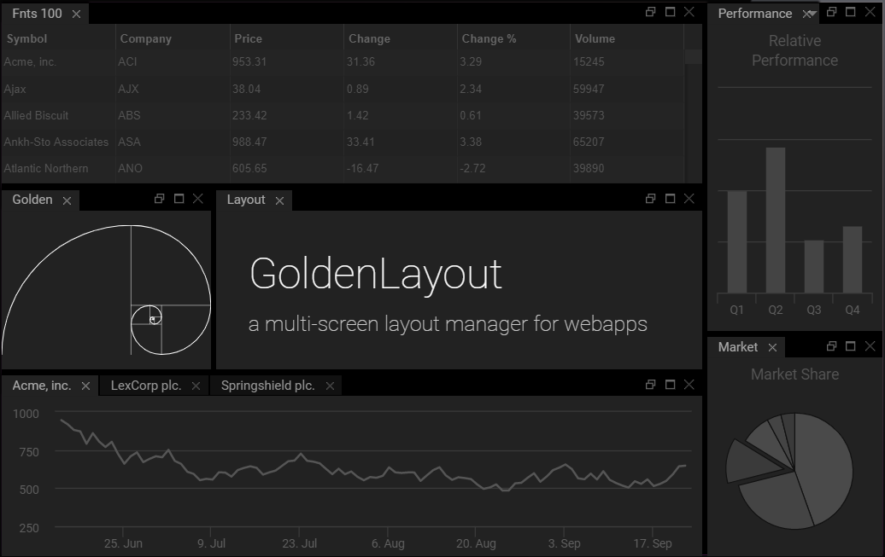
Window Managers

Slide 7
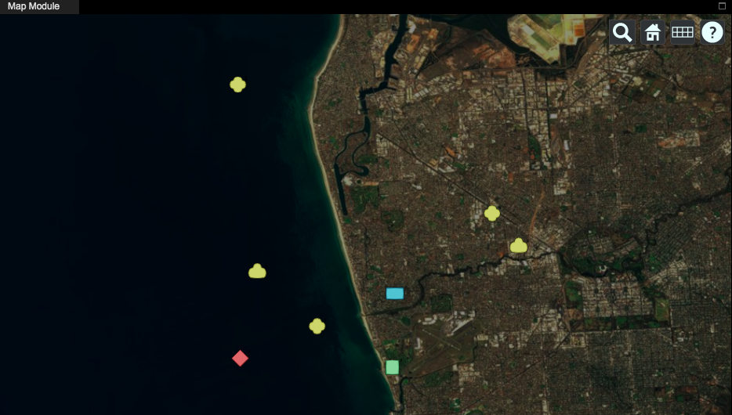


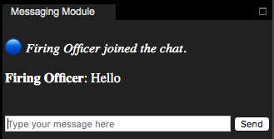

Modules
Messaging
Track table
Track changes reflected on map

Slide 8
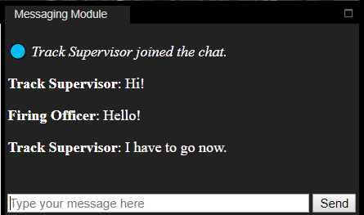
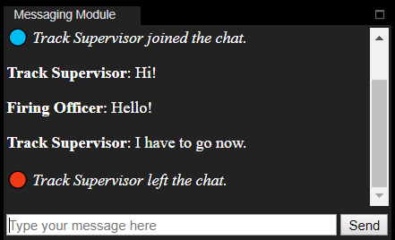
Messaging Module
Messages need to appear on other operator’s browsers.
Used Socket.io library for client-server communication
Styling is simple but intuitive

Slide 9
Map Module
Tracks need to update upon classification
Track’s appearance needed to follow military guidelines
Used Milsymbol library to make icon generation easy

Slide 10
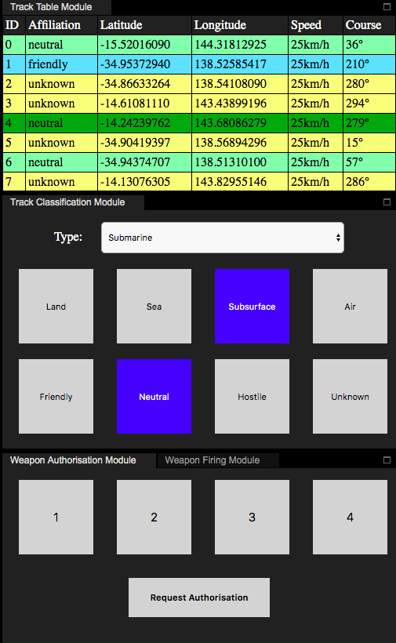
Track Table
Shows key track information
Rows are linked to a track object via ID
Colour coded tracks
Reactive to hovering
Notes:
Keeping in mind that we wanted this system to be intuitive and user-friendly, I chose to colour code each track in the table according to their affiliation – friendly, neutral, unknown and hostile – so that this way, when an operator looks at the system, they would easily be able to know the affiliation of a track. Furthermore, tracks are highlighted as you hover over them or when they are selected. Since this system is built for military use, the mouses that military operators use may be awkward to use so I’ve also made the elements reactive to hovering so that an operator will always be sure of where their cursor is pointing at.

Slide 11
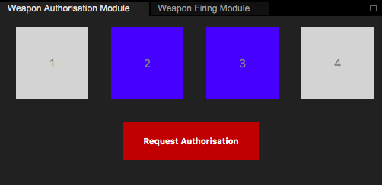
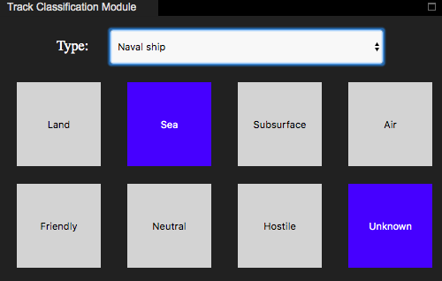
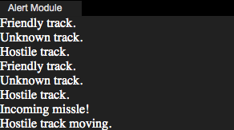
Modules
Track classification
Alerts
Weapons

Slide 12
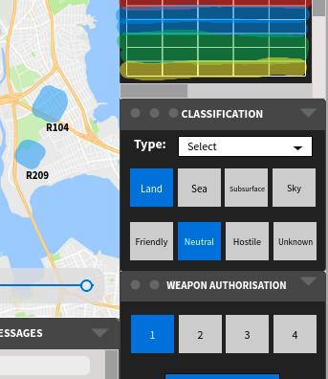
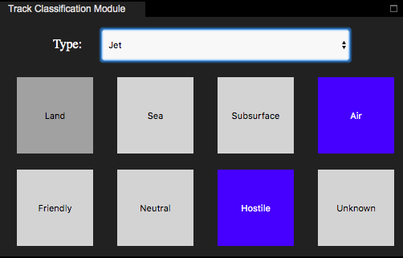
Track Classification
Hi-Fi Design
Prototype
Notes:
The track classification module is used for the classification of tracks in the system. When implementing this module, there were 2 requirements I had to consider. One was how the module would allow an operator to change the properties of a track. I designed it so that when an operator clicked on a track in the track table, they would be able to classify the selected track by clicking the buttons corresponding to its domain and affiliation.
As you can see, this was my initial hi-fi design which was based on the existing training system that was demonstrated to us at DST. I implemented this module according to those designs – a dropdown menu for the track’s type, and a row of buttons for the track’s domain and another row for the track’s affiliation. From our previous literature review, we found that to implement an effective UI, it is important for a user to be able to intuitively know what a button does based on its name or icon and buttons should be big enough to be easily read and clicked. Therefore, I made sure the buttons I implemented were large and easy to interpret.
The second requirement I had to consider for this module was to allow an operator to view the properties of a track. For this, I felt that it was intuitive to make the buttons themselves reflect the track properties. For example, when a classified track is selected, the buttons corresponding to its domain and affiliation would promptly change to blue to show the track’s current properties. I chose the colour blue because it is a bold colour that stands out in both light and dark themes. I avoided other bold colours like red for this because we don’t want to alarm an operator since the colour red generally represents urgency or hostility. I have also kept the reactive hovering theme consistent in this module by highlighting the buttons a slightly darker colour when an operator’s mouse hovers over them.

Slide 13
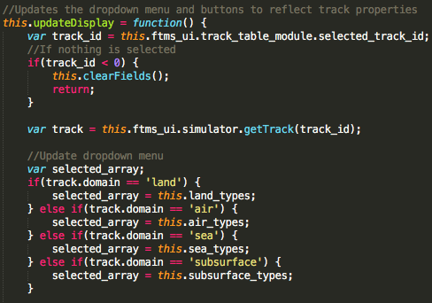
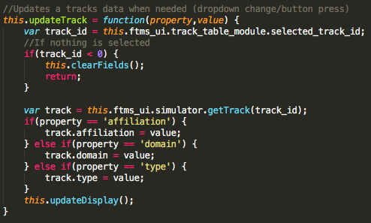
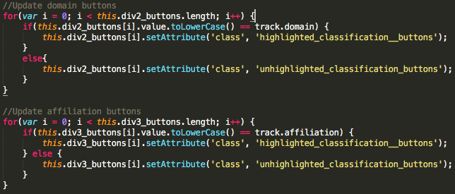
Track Classification
updateDisplay()
updateTrack()
Notes:
So to implement this module, the main two functions used were updateTrack() and updateDisplay(). updateTrack() gets called whenever you click a button or change the dropdown selection and it calls the updateDisplay() function to reflect those changes.
The updateDisplay() function first looks at which track is currently selected, checks the tracks properties and then updates and highlights the appropriate elements.
It’s important for the system to allow tracks to be accessed from any module so that information across the webpage always remains consistent. With our current prototype, it’s easy for any module to access tracks because they are locally stored on the client’s web browser. However once we need the changes from one operator’s browser actions to be reflected on the interfaces of all other operators, we will need to use a more complex track management system. This means we will need to refactor the way that our modules access tracks and their properties, which we plan to work on next semester.

Slide 14
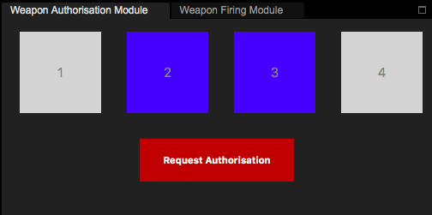
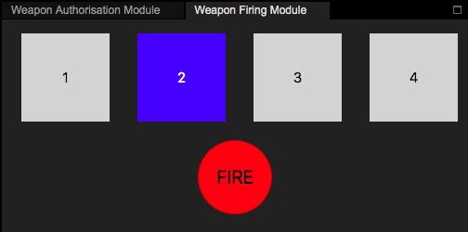
Weapon Authorisation
Weapon Firing
Requirement: allow an authorised operator to authorise and un-authorise the firing of selected weapons against a track
Requirement: allow authorised operators to fire weapons that have been authorised for firing
Notes:
For the weapon authorisation module, I had 1 requirement that I had to keep in mind which was to allow an authorised operator to authorise and un-authorise the firing of selected weapons against a track. Since we don’t yet know what the weapons are, I’ve just numbered them 1,2,3,4 as placeholders. For consistency, as required by one of our non-functional usability requirements, I’ve kept the same button styling that was used in the track classification module. However, this time, I’ve chosen the request authorisation button to be red because requesting for a weapon is considered to be an important and sensitive action so using the colour red will signify that the operator needs to be aware and cautious of this button. When the request authorisation button is pressed, I have also made it so that the weapons buttons will become disabled until the request button is unselected.
Similarly, for the weapon firing module, I’ve used the same button styling but this time there is a firing button instead of a request authorisation button because this module will only be accessible for authorised operators to fire weapons that have been authorised for firing. I’ve also used the colour red to further emphasise the significance of this button.
These modules do not have the correct functionality yet but when we continue to work on our system next semester, I am planning to implement an authorisation approval module so that these 3 weapon modules will function consistently across one another. How this will work is that when an operator requests authorisation for a weapon, an approval request will be sent to any operator that has the appropriate privileges to approve the request. And once approved, a firing officer will then be able to fire that weapon against a given track.

Slide 15
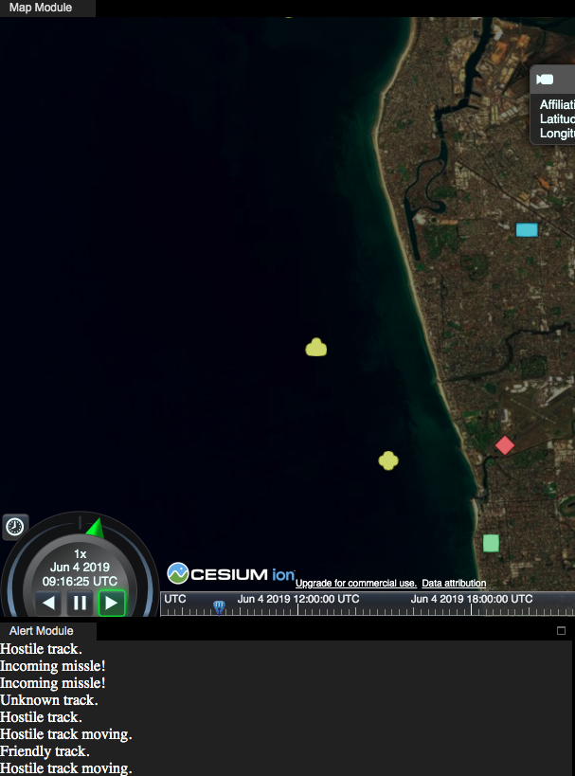
Alerts
Array of alerts
Function that adds random alerts to the display
Notes:
Lastly for the alerts module, I’ve created a display and for now it just randomly shows pre-set alerts.
I created a div for the alerts to sit in, populated an array with possible alerts, and made a function that adds random alerts from that array to to the top of the alert div. Eventually, the client’s event replay tool will produce more realistic alerts but this is what we have for now. I haven’t given much thought to the style of the alerts yet just because I know the style will probably have to change once we know more about how the alerts will be formatted.

Slide 16
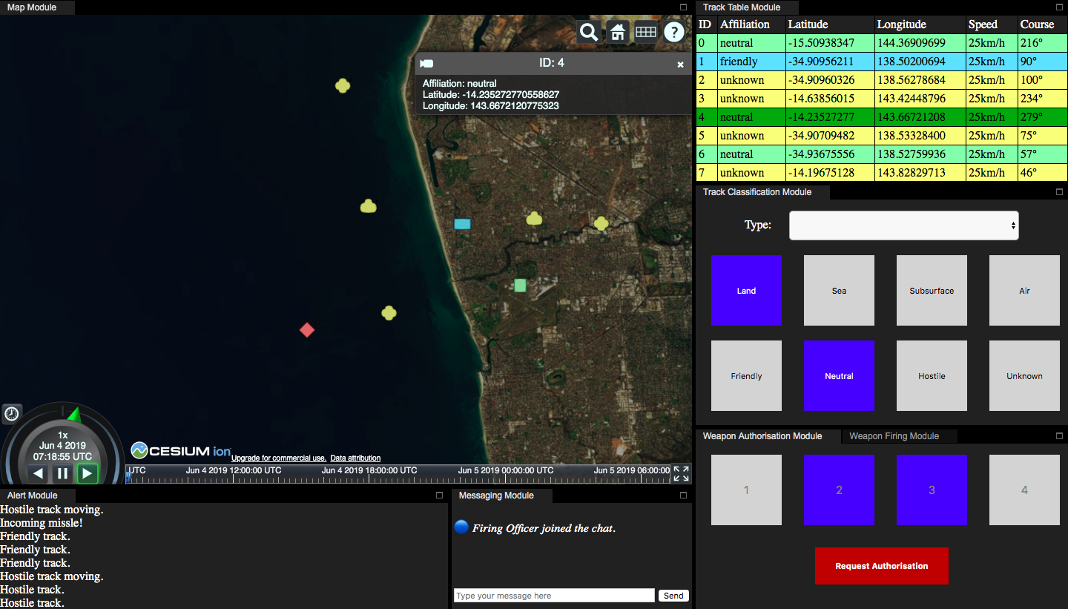

This is your App Demo
UI
Notes:
In general, I’ve implemented these modules with consideration to our functional and non-functional requirements. I have kept the colour scheme, fonts, and element shapes consistent throughout all modules to ensure the system is intuitive enough that an operator would be able to navigate through the system effectively.

Slide 17
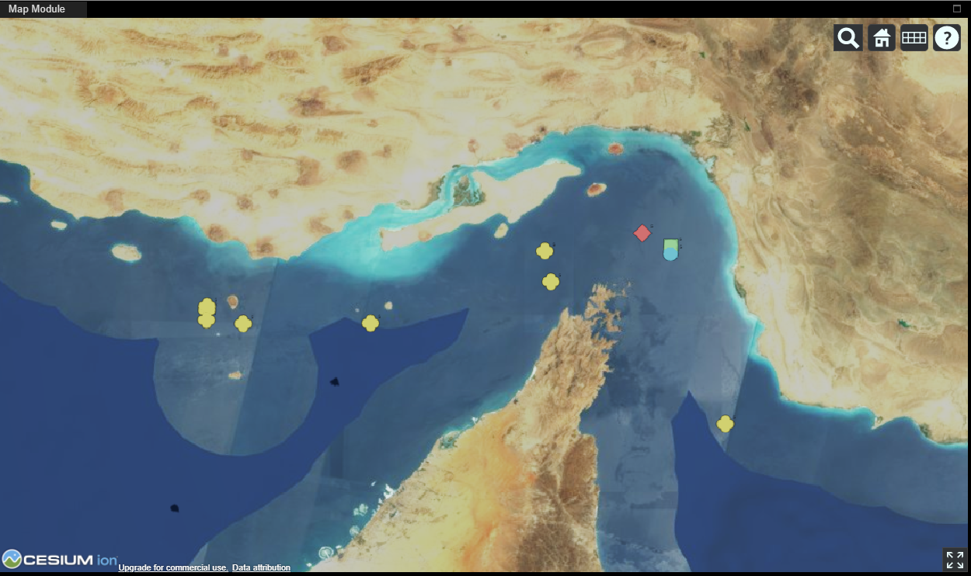
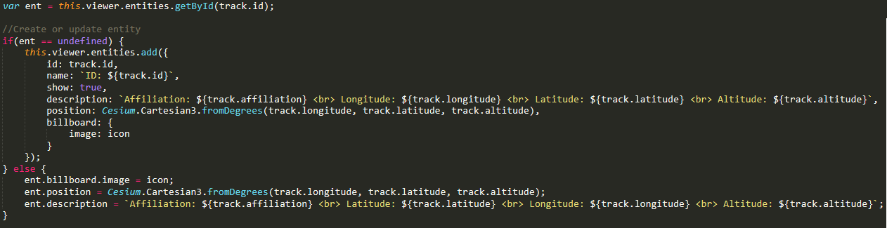
Cesium JS
Adding a Track to our Map
Notes:
Why?
Was suggested by clients and I have experience with it
Using prior experience with Cesium it was a simple setup
The base setup was the same as what I've used before
The rest was gutting Jared's simulator display and just making it create and update entities on the Cesium map instead of the original.
This satisfies our functional requirements MAP one through six.

Slide 18
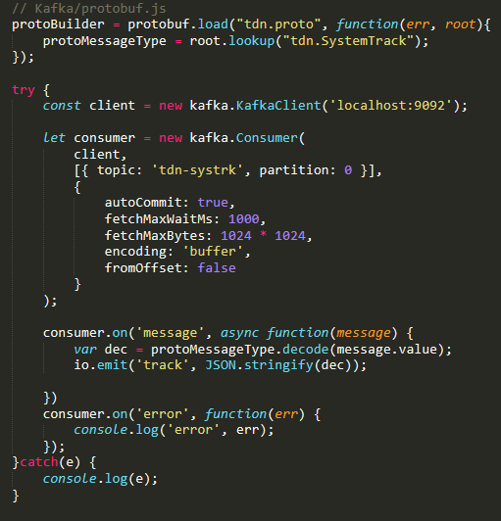
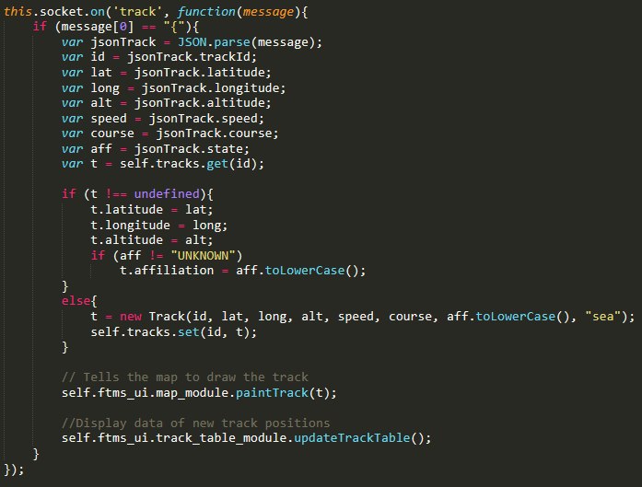
Apache Kafka
Kafka-node, Socket.io, protobufjs
Socket.io (Client Side)
Kafka-node & protobufjs
Notes:
Why?
Apache Kafka was suggested by client
The rest were all popular choices for their purpose so I figure there would be more support for them
New to me
Started with kafka command line, had trouble running it with Java version
Found kafka-node
Tested this by producing from kafka command and logging it all on the Node server
Getting data to clients, searches recommended Web Sockets, socket.io
Socket.io easy setup, followed a tutorial and changed their parts for what I need
Client interpret JSON objects and create tracks. Turned off the simulator and used it “house” the JSON to Track code, then map module.
No event replay, python script, inconsistent timing, inconsistent production to kafka
Client fixed event replay, no python script, do proto buffer
Protobufjs, no API documentation, API fixed 2 days ago, irrelevant Git issues
Trial and error using old documentation, then finally got an object
Logging gave no information on keys
Hour of looking through protobuf issues, found generic solution, Object.keys(), JSON.stringify(), update client code for new json object
Event replay longitude was latitude
Event replay not working on laptop
Searching irrelevant problems, client couldn’t reproduce problem, error was connection based, kafka port from Java library
Jared said Track Table broken, random alerts broken, updated Track Table use new track data, gutted simulator, run only Alerts

Slide 19
Thank you for listening!

